Slide 1

Company Law (LC2008C) 7. Corporate constitution and membership (PART I)
LC2008C
Kenneth Khoo
kenneth.khoo@nus.edu.sg

Slide 2

Corporate constitution and membership
Introduction and Theoretical Background
Contents of the Constitution
The Constitution as a Contract
Membership and Outsider Rights
Outsiders
The Qua Member Rule

Slide 3
Corporate constitution and membership
Altering the Constitution
General Principles
Restraints on Alteration
Entrenching Provisions
Bona Fide in the Company’s Interests
General Principles
Conflicting Shareholder Interests
Compulsory Share Transfers

Slide 4
Introduction and theoretical background
Recall Slide Deck 2. There, we spoke about the idea that Company Law is often seen as a “special type of contract” amongst different stakeholders of the firm (e.g. a “contract” between the company’s shareholders, directors, etc.)
Since the company is a separate legal person, the company itself can also be a party to this “contract”
This view of the company is referred to as the contractarian approach to Company Law.
Thus far, Topic 3 (Corporate Acts and Liabilities) has been on the “external dimension” of the Company – that is, the legal relationship between the company as a separate legal person and 3P creditors, who are seen as “outsiders” of the Company.

Slide 5
Introduction and theoretical background
In this topic (Corporate Constitution and Membership), we will focus on the legal relationship between the “insiders” of the Company, particularly in relation to shareholders.
To simplify the analysis, we can think of “insiders of the company” as comprising of non-creditors – i.e. directors and shareholders.
Since the company is also a separate legal person at law, the company may also be considered an “insider” [consider why].
Although we will focus on shareholder rights in this topic, the corporate constitution plays an important role in defining the powers of the board. We will deal with the powers of the board and the duties that board members owe to the Company in subsequent topics (Topic 5: Corporate Organs and Decision-Making and Topic 6: Directors’ Duties)

Slide 6
Introduction and theoretical background
Back to Slide Deck 2. As you might recall, the contractarian view of the corporation gave rise to two traditional justifications for the existence of Company Law.
First, company law sought to facilitate contracting between multiple parties, providing default rules that reduce the costs of contracting.
Second, company law sought to address contracting problems (conflicts of interest) that arise in the unique multilateral contract between “insiders” of the company.
The rules relating to the corporate constitution play an important role in both:
In relation to (1), “Model Constitutions” provide a set of default rules that companies are presumed to adopt should they fail to register their own constitutional provisions.
In relation to (2), Company Law places restrictions on how “insiders” of a company can enforce or amend the company’s constitution.

Slide 7
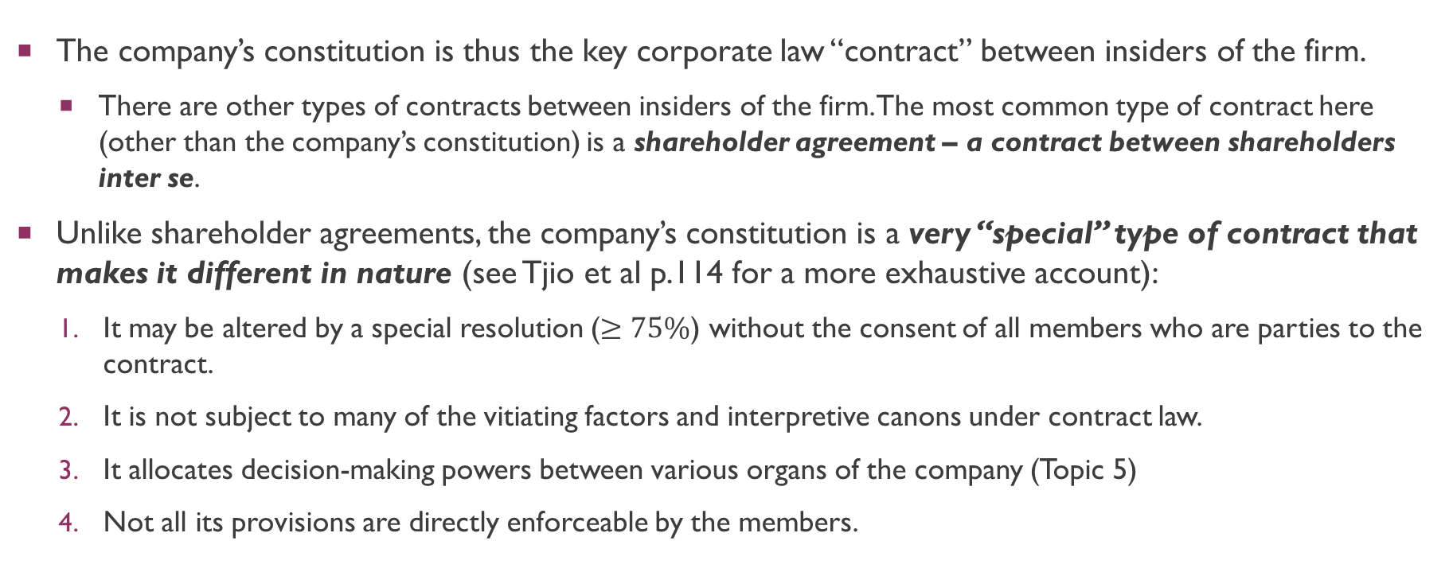
Introduction and theoretical background
The company’s constitution is thus the key corporate law “contract” between insiders of the firm.
There are other types of contracts between insiders of the firm. The most common type of contract here (other than the company’s constitution) is a shareholder agreement – a contract between shareholders inter se.
Unlike shareholder agreements, the company’s constitution is a very “special” type of contract that makes it different in nature (see Tjio et al p.114 for a more exhaustive account):
It may be altered by a special resolution ($≥75\%$) without the consent of all members who are parties to the contract.
It is not subject to many of the vitiating factors and interpretive canons under contract law.
It allocates decision-making powers between various organs of the company (Topic 5)
Not all its provisions are directly enforceable by the members.

Slide 8
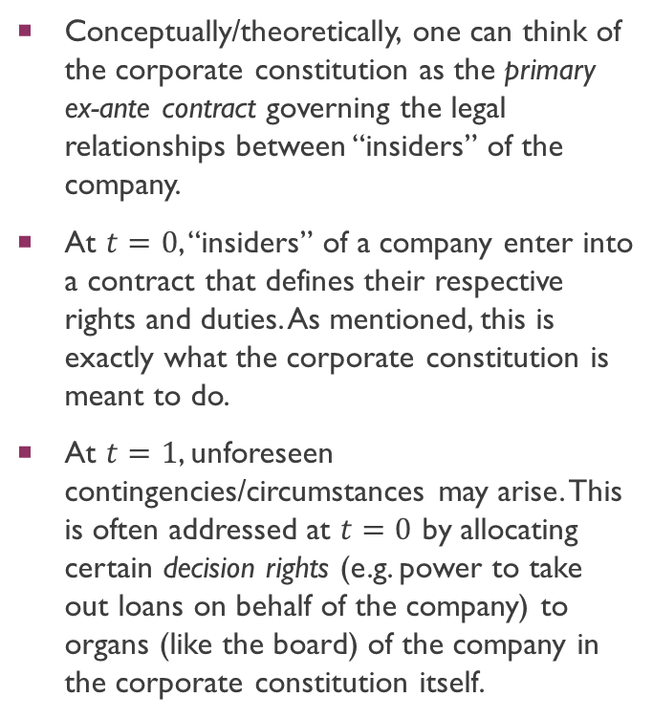
Introduction and theoretical background
Corporate Constitution
Conceptually/theoretically, one can think of the corporate constitution as the primary ex-ante contract governing the legal relationships between “insiders” of the company.
At $t=0$, “insiders” of a company enter into a contract that defines their respective rights and duties. As mentioned, this is exactly what the corporate constitution is meant to do.
At $t=1$, unforeseen contingencies/circumstances may arise. This is often addressed at $t=0$ by allocating certain decision rights (e.g. power to take out loans on behalf of the company) to organs (like the board) of the company in the corporate constitution itself.
Ex Post “Gap Filling” via allocation of decision rights
Ex Ante Contract
time
0
1

Slide 9
Introduction and theoretical background
Corporate Constitution
Instead of allocating decision rights (which the shareholders might not be entirely pleased with) to the board of directors, could the shareholders amend the corporate constitution every time a decision arose?
E.g. Consti allows for directors to borrow money on behalf of coy. Directors then make decision to borrow money from DBS. What if shareholders disagree with directors and wanted to borrow money from OCBC instead? Would amending the constitution be possible?
Yes, they could. In fact, this is what commercial parties actually do in some complex and long-term relational contracts.
However, this also defeats the entire idea of the separation of ownership from control!
Ex Ante Contract
Amending the Constitution?
time
0
1

Slide 10
Contents of the constitution
Prior to the changes introduced by the Companies (Amendment) Act 2014 (which commenced on 03 Jan 2016), two documents formed a company’s constitution: the memorandum of association (“MOA”) and articles of association (“AOA”).
The purpose of the MOA was to set out important statutorily mandated information for the benefit of 3P creditors and potential shareholders, while the purpose of the AOA was to determine the internal regulations of the company.

Slide 11
Contents of the constitution
The Companies (Amendment) Act 2014 replaced both the MOA and AOA with a single-document constitution.
As a result, companies incorporated on or after 03 Jan 2016 are required to adopt constitutions in the form of a single document
Companies incorporated prior to that date may continue to be regulated by the MOA and AOA.
However, the difference between the two (i.e. the constitution and the MOA+AOA) is one of form only, and so the Companies Act regulates both forms by the same rules (with very limited exceptions).

Slide 12
Contents of the constitution
Under s 4 of the Companies Act, the constitution is defined to mean:
(a) the constitution of the company which is registered with the Registrar under section 19, as may be amended from time to time; and
b) in the case of a company incorporated before the date of commencement of section 3 of the Companies (Amendment) Act 2014, the memorandum of association of the company, the articles of association of the company, or both, in force immediately before that date;

Slide 13
Contents of the constitution
Under s 22(1) of the Companies Act, it is mandatory for the company’s constitution to include (inter alia):
The name of the company
If the company is a company limited by shares, that the liability of the members is limited (without this statement, the members will have unlimited liability)
The full names, etc. of the subscribers to the constitution of the company.
s 35(1) requires that the company’s constitution contain the regulations (the old articles of association) for the company.
As mentioned in a previous lecture, under s 23(1) companies have as a default rule “full capacity to carry on or undertake any business or activity, do any act or enter into any transaction, and full rights, powers and privileges.” However, they may choose to have objects, or may restrict the company’s capacity, rights, powers or privileges (s 23(1A) and 23(1B)).

Slide 14
Contents of the constitution
s 36(1) states that “The Minister may prescribe model constitutions for (a) private companies; and (b) companies limited by guarantee [collectively referred to as specified companies]”.
These model constitutions are provided pursuant to the Companies (Model Constitutions) Regulations 2015.
s 37(1) states that “a specified company may adopt as its constitution the whole or any part of the model constitution prescribed under section 36(1) for the type of company to which it belongs.”
System of default rules that reduces the costs of contracting. But only applies to “specified companies” (i.e. non-public companies).
S 37(4) states that “a copy of the constitution of a specified company shall be submitted to the Registrar… where the specified company — (a) adopts only part of the model constitution for the type of company to which it belongs; (b) includes provisions additional to those in the model constitution; or (c) includes object clauses as part of its constitution”.
Notes:
Default constitution is v sticky

Slide 15
The constitution as a contract
s 39(1) states that “Subject to this Act, the constitution of a company shall when registered bind the company and the members thereof to the same extent as if it respectively had been signed and sealed by each member and contained covenants on the part of each member to observe all the provisions of the constitution.”
Thus, the constitution of a company derives its contractual binding force by way of statute. Unlike typical contracts that arise from a bargain amongst parties, the elements of formation are substituted with the act of registration.
Observe that the constitution of a company binds the company and its members. This means that each party (i.e. each member of the company) is bound to every other member and the company itself.
“The articles of association constitute a contract not merely between the shareholders and the company, but between each individual shareholder and every other…” (Wood v Odessa Waterworks Co (1889) (Stirling J))

Slide 16
The constitution as a contract
Figure 1
As an illustration of this, consider Figure 1 on the right, where A, B, and C are members of a company.
Pursuant to s 39(1) CA, member A is bound to B, C, and the company.
Similarly, member B is bound to A, C, and the company.
Likewise, the company is bound to A, B, and C.
The corporate constitution is thus a multilateral contract, binding the members inter se.
Each member has a personal right to bring an action against any other member or the company to enforce a regulation of the constitution or to restrain its breach.
B
Company
A
C

Slide 17
Contents of the constitution
Each member has a personal right to bring an action against any other member or the company to enforce a regulation of the constitution or to restrain its breach.
In Rayfield v Hands [1960] Ch 1, it was held that a member could compel the company’s other members (who were also directors) to purchase his shares as required by the company’s articles even though the company was not joined to the suit.

Slide 18
Members and outsider rights
Recall the legal effect of s 39(1) of the Companies Act – the constitution of a company binds the company and its members inter se.
An important implication stems from s 39(1): a person who is not a member of the company would usually have no standing to sue, or be sued against in connection with the rights or obligations conferred by the constitution.
For ordinary contracts, this follows from the doctrine of privity in contract law. This doctrine is subject to the Contract (Right of Third Parties) Act (Cap 53B, 2002 Rev Ed) (“CRTPA”), but a company’s constitution is exempted from the operation of the CRTPA (see s 7(2) of the CRTPA).
Thus, “outsiders” of the company generally cannot enforce rights or obligations conferred by the constitution.

Slide 19
Members and outsider rights: outsiders
Figure 2
As an illustration of this, consider Figure 2 on the right.
“Outsiders” of the Company are not part of the “statutory contract” set out in s 39(1) CA.
Therefore, they have no standing to sue, and cannot be sued against in connection with the rights or obligations conferred by the constitution.
In line with the doctrine of privity of contract.
Can be thought of as distinct “sets” (c.f. Slide 22)
“Outsiders”
Members + Company

Slide 20
Members and outsider rights: outsiders
Eley v Positive Government Life Assurance Co (1876) 1 Ex D 88
Facts: The AOA of PGS contained a clause which provided that Eley should be the company’s solicitor and should not be removed from office, unless for misconduct. After some time, PGS ceased to employ Eley and employed other solicitors in Eley’s place. Eley brought an action against the company for breach of contract in not employing him as the company’s solicitor.
Held: Eley could not bring an action against the company, as the articles bound only the company and its members. Since Eley was not a shareholder, he was not a party to this contract.
The facts in Eley are peculiar, as Eley subsequently acquired shares in the company 11 months after its incorporation and was a member by the time of the suit. However, this issue was not addressed in Eley and so was not part of its ratio. See Hickman later.

Slide 21
Members and outsider rights: outsiders
Malayan Banking Ltd v Raffles Hotel Ltd [1965-1967] SLR(R) 161
Facts: The owners of Raffles Hotel leased part of the property to one Mr. Sarkies and one Mr. Arathoon. Subsequently, Mr. Sarkies and Mr. Arathoon went insolvent, and so the lease was assigned to the plaintiff company. Art 77 of the plaintiff’s AOA empowered the lessors and their assigns [i.e., the owners] to appoint a director in the plaintiff company. Subsequently, the defendant owners tried to appoint such a director, but the plaintiffs claimed that this was inconsistent with the terms of the lease.
Held: The lessor (i.e. the defendants) could not exercise the right to appoint and remove directors of the lessee company (i.e. the plaintiffs) that was expressly conferred upon the lessor by the lessee’s articles of association.
Not being a member of the lessee company, the lessor was an outsider with no standing to enforce the contract between the lessee and its members.

Slide 22
Members and outsider rights: qua member rule
The situation becomes more complex when a member tries to enforce a provision in the company’s constitution that is said to concern a non-member or an outsider right.
Figure 3 illustrates this dilemma: members of a company can also be creditors of the same company.
The shaded region represents a member who is trying to enforce a provision that concerns a non-member right.
Can be thought of as intersecting “sets” (c.f. Slide 19)
Can these rights be enforced? Ans: The starting position (i.e. prima facie) is that these rights cannot be enforced. This is known as the “qua-member rule”.
Figure 3
Members
“Outsiders”
Members + “Outsiders”

Slide 23
Members and outsider rights: qua member rule
Hickman v Kent or Romney Marsh Sheepbreeders Association [1915] 1 Ch 881
Facts: The company’s AOA stated that any dispute between the association (i.e. the company) and a member should go to arbitration. Hickman had a dispute with the association concerning the association’s refusal to register his sheep in the published “flock book” and was under threat of being expelled. Instead of proceeding to arbitration, however, Hickman commenced proceedings in the High Court instead.
Held: Hickman was bound by the AOA as a member, and therefore had to comply with the AOA’s clause regarding arbitration.
Laid down the rule now known as the “qua-member rule” which stipulates that only rights conferred upon members in their capacity as a member are enforceable.
In this case, Hickman was a member and was suing in his capacity as a member, and so was bound by the AOA.

Slide 24
Members and outsider rights: qua member rule
Hickman v Kent or Romney Marsh Sheepbreeders Association [1915] 1 Ch 881
Held: Astbury J cited Eley as authority for the principle that only rights conferred on members in their capacity as members are enforceable.
Recall: In Eley, the plaintiff acquired shares in the company after its incorporation (which at the time stipulated that Eley was to be appointed as the company’s solicitor) and was therefore a member by the time of the suit.
However, this distinction was not drawn upon by the court in Eley and so is not part of its ratio.

Slide 25
Members and outsider rights: qua member rule
Hickman v Kent or Romney Marsh Sheepbreeders Association [1915] 1 Ch 881
“I think this much is clear, first, that no article can constitute a contract between the company and a third person; secondly, that no right merely purporting to be given by an article to a person, whether a member or not, in a capacity other than that of a member, as, for instance, as solicitor, promoter, director, can be enforced against the company; and, thirdly, that articles regulating the rights and obligations of the members generally as such do create rights and obligations between them and the company respectively.”

Slide 26
Members and outsider rights: qua member rule
Hickman does not discuss the scope of what “a capacity… of a member” is.
What exactly are the “member rights” which inform the qua-member rule?
At a bare minimum, one could argue that the rights accorded to the members by the Companies Act and the Common Law form an “irreducible core” of a member’s rights. Intuitively, we can think of these rights as a bundle of [limited] control and cash-flow rights over the Company. We will learn more about these rights in the topic “Corporate Finance”:
Right to attend meetings and vote (e.g. s 180 CA)
Rights to information (e.g. s 196A)
Shareholder actions (e.g. s 216, s 216A, etc.)
Exit Rights (e.g., in Rayfield)
However, an alternative view has been advanced by cases discussing the case of Quin & Axtens Ltd v Salmon [1909] AC 442 (HL)…

Slide 27
Members and outsider rights: qua member rule
Quin & Axtens Ltd v Salmon [1909] AC 442 (HL)
Facts: Salmon (S) and Axtens (A) were both majority shareholders and the directors of Quin & Axtens Ltd. The AOA of Quin & Axtens Ltd provided that (1) the directors should manage the business and exercise all the powers of the company (Art 75) and (2) that no board resolution which had its object (inter alia) the acquisition of letting of certain premises would be valid if either S or A dissented (Art 80). Notwithstanding Art 80, however, the board of directors decided (via board resolution) to acquire and let various properties. S dissented to this. An extraordinary meeting was then called at which the majority of the shareholders passed a resolution endorsing the prior decision made by the board of directors. S (and other dissenting shareholders) sought an injunction against the company, which succeeded at first instance. The company appealed.

Slide 28
Members and outsider rights: qua member rule
Quin & Axtens Ltd v Salmon [1909] AC 442 (HL)
Held: The bargain made between the shareholders was contained in articles 75 and 80 of the articles of association.
Hence, the company would be restrained from acting upon any resolutions made by the company (either by the board or at the general meeting) that were inconsistent with these articles.
If S objected to the board resolution, the discretion of the company did not revert to the shareholders at the general meeting (next topic).
Note: The argument could have been made that Art 80 did not concern a member right, but rather a management right involving directors. If Salmon were to enforce Art 80, would this be consistent with the “qua member rule” (although Quin was decided prior to Hickman)? This was not argued in court and therefore not addressed.

Slide 29
Members and outsider rights: qua member rule
Wedderburn (1957) has argued that Quin is authority for the proposition that a shareholder may always enforce the articles because he has, in common with all other members, the right to have the articles observed.
Lord Wedderburn argued that since Salmon had clearly acquired the right to veto board resolutions in an "outsider" capacity (i.e. as director), he could not have been permitted to enforce that right directly if it is to be consistent with the “qua-member rule”.
Thus, the reason why he succeeded in his action must be located in a specific member right, which Lord Wedderburn identified as the right to have the company's constitution observed.
Greatly waters down the scope of the qua-member rule.

Slide 30
Members and outsider rights: qua member rule
Independent State of Papua New Guinea v PNG Sustainable Development Program Ltd [2016] 2 SLR 366 (HC)
Facts: The Independent State of Papua New Guinea sought to inspect the true accounts, books of accounts, and/or records of a company, PNGSDP. The State argued that it had a right of inspection under the MOA and AOA of PNGSDP.
Held: There could be no right of inspection under the MOA and AOA of PNGSDP. PNGSDP was correct to submit that the State, as a nonparty to the MOA and AOA of the company, had no standing to enforce the MOA and AOA even if it purported to confer rights on the State.

Slide 31
Members and outsider rights: qua member rule
Independent State of Papua New Guinea v PNG Sustainable Development Program Ltd [2016] 2 SLR 366 (HC)
Held: There was no common-law right for non-members of a company to enforce the company’s MOA and AOA.
Comment: Justice Prakash (now JA) provides a long discussion of the relevant authorities (from [36] – [63] (worth reading in full))
After considering caselaw from Singapore, the UK, Australia, Hong Kong, Canada and New Zealand, Justice Prakash suggests that none of the authorities in these common law jurisdictions show that third parties can derive rights from the MOA and AOA.
However, she does seem to endorse Lord Wedderburn’s interpretation of Hickman (at [47]).

Slide 32
Members and outsider rights: qua member rule
Independent State of Papua New Guinea v PNG Sustainable Development Program Ltd [2016] 2 SLR 366 (HC)
At [47]: “The State calls in aid that the Hickman principles have “given rise to much academic debate” and “may not be wholly desirable” (Walter Woon on Company Law (Tan Cheng Han SC gen ed) (Sweet & Maxwell, Revised 3rd Ed, 2009) (“Walter Woon”) at paras 4.50–4.52) and have been outflanked by cases which have let members enforce rights afforded to it in other capacities. In my view, these do not bring the State very far. Those cases (and the corresponding comments in Walter Woon) relate to the second principle in Hickman (which states that a member may only enforce a right in the M&A qua member). In any event, these cases may now be explained on the basis that a member has a right to require the company to act in accordance with its M&A even if the result would be indirectly to protect a right given to him in another capacity.”

Slide 33
Members and outsider rights: qua member rule
Comments on Independent State of Papua New Guinea by Dan W Puchniak and Tan Cheng Han in ‘Company Law’ (2016) 17 SAL Ann Rev 235
“[State of Papua New Guinea] represents a school of thought that although a member cannot directly enforce a provision that does not affect members in their capacity as members, they may require the company to act in accordance with its constitution, this being a member’s right. This, of course, completely undermines the “qua member” requirement as it means that a member may potentially, through injunctive relief, cause a company to act in accordance with the entirety of its constitutional provisions whether they affect the member in such capacity or not. The authors are not averse to this as such interpretation could be said to accord better with the literal language of s 39(1) and enhances shareholder rights.”

Slide 34
Members and outsider rights: qua member rule
Comments on Independent State of Papua New Guinea by Dan W Puchniak and Tan Cheng Han in ‘Company Law’ (2016) 17 SAL Ann Rev 235
“Having said this, there is an intermediate approach. Such an approach will take into account the context behind the constitutional provision in determining if, on the facts, they give rise to a ‘qua member’ right. In other words, a particular provision may have been inserted as an incident of membership or to induce a person to become a member of the company. Such provisions are common and include rights of representation on the board and deadlock rights. The exercise of such rights has been upheld even though they may involve matters of management rather than matters that affect a member in such capacity unless “qua member” is understood more broadly.”

Slide 35
Members and outsider rights: qua member rule
Drury, “The Relative Nature of a Shareholders Right to Enforce the Company Contract” [1986] CLJ 219
Drury argues that the corporate contract is unlike a typical discrete transaction, as the corporate contract regulates long-term relationships (recall the “gap-filling” intuition).
Company law includes within its scope a number of [internal] processes for resolving or mitigating disputes, recognizing the polarizing and disruptive effect of litigation.
Key mechanism: Via ordinary or special resolutions – use of the special majority’s power to alter the contracting parties’ [i.e., minority] rights for the future can determine outcome of dispute.
E.g. If an outsider’s rights in company’s constitution are infringed, a (special) majority of shareholders can threaten to use this power (to alter the constitution) to settle differences [between themselves and the minority] should they be convinced that the outsider’s rights are beneficial to the company.

Slide 36
Members and outsider rights: qua member rule
Drury, “The Relative Nature of a Shareholders Right to Enforce the Company Contract” [1986] CLJ 219
Thus, the qua-member rule may be seen as a rule that attempts to constrain litigation by resolving conflicting shareholder interests through the company’s internal processes.
Why? Because outsider rights are indirectly protected if a majority of corporate stakeholders agree that it should be protected.
Drury argues that Eley is a good illustration of such competing tensions.
In Eley, one could argue that when the articles were read as a whole, the power to appoint the company’s solicitors still resided in the board of directors.
Thus, there was an inherent conflict with a textualist reading of the articles which provided the right for Eley to be solicitor vis-à-vis a reading of the articles which vested power to appoint solicitors in the board.

Slide 37
Members and outsider rights: qua member rule
Drury, “The Relative Nature of a Shareholders Right to Enforce the Company Contract” [1986] CLJ 219
If Eley had managed to persuade the board of directors to appoint him, the case would not have proceeded to litigation.
Similar argument applies for shareholders: “The opinion of the majority of shareholders was presumably against Eley, otherwise the case would not have been brought.”
C.f. views by Goldberg and Prentice (described in Drury’s article).

Slide 38
Members and outsider rights: qua member rule
What does the qua-member rule mean for outsiders?
As a practical matter, an outsider (say, a creditor) who has no standing to enforce a term of the constitution is not without legal recourse. Why? Because he/she can contract directly with the company as a separate legal person.
Indeed, this was precisely what happened in Salomon v A Solomon & Company Ltd. Salomon contracted with Salomon & Co Ltd in the capacity of a secured creditor.
If additional protection is needed, the outsider can even enter into personal contracts vis-à-vis the existing shareholders of the company.
All of the aforementioned reasoning also applies to other non-members (i.e. outsiders) like directors and company secretaries.

Slide 39
Members and outsider rights: qua member rule
can contract with
Shareholders
Corporate Constitution
Outsider (e.g. Director)
can contract with
Company

Slide 40
Members and outsider rights: qua member rule
In Australia, section 140(1) of the Corporations Act 2001 states that the constitution takes effect as a contract not only between a company and its members but also between the company and its directors and company secretaries.
“A company's constitution (if any) and any replaceable rules that apply to the company have effect as a contract: (a) between the company and each member; and (b) between the company and each director and company secretary; and (c) between a member and each other member”.
In Australia, directors can thus enforce the terms of the constitution in their own capacity.
Should directors be considered as “insiders” of the company and therefore a quasi “member” of sorts?
In Singapore, however, the Company Legislation and Regulatory Framework Committee examined the position (in 2002) and decided to follow the UK in leaving the position as it stands at common law.

Slide 41
Members and outsider rights: qua member rule
Finally, note that an extrinsic contract can still incorporate the terms of a company’s constitution by reference or implication.
E.g. in Swabey v Port Darwin Mining Co [1889] 1 Meg 385, a director was held to be entitled to the remuneration stated in the company’s articles.
Although the articles did not constitute a contract between the company and the director, he had nevertheless contracted with the company on the terms stated in the articles.
Thus, the former contract incorporated the terms relating to remuneration in the company’s articles.
Note: While valid, incorporating terms in a company’s constitution exposes the contracting parties to the risk that such terms may be amended by a special majority of the company’s shareholders.

Slide 42
Q&A
See you guys next class.

Slide 43
bibliography
Deck 8 Slide 4: “Recall Slide Deck 2. There, we spoke about the idea that Company Law was (until Hansmann and Kraakman, 2000) traditionally seen as a “nexus of contracts” between different stakeholders of the firm (e.g. a “contract” between the company’s shareholders, directors, etc.) (Easterbrook and Fischel, 1996)” is from “The Ownership of Enterprise”, Henry Hansmann, (Harvard University Press, 2000) and “The Economic Structure of Corporate Law”, Frank H. Easterbrook, Daniel R. Fischel, Harvard University Press (1996).
Deck 8 Slide 9: “Yes, they could. In fact, this is what commercial parties actually do in some complex and long-term relational contracts (Macneil, 1985; Bernstein, 1992). “ is from “Reflections on Relational Contract” Ian R. Macneil Journal of Institutional and Theoretical Economics Bd. 141, H. 4. (December 1985), pp. 541-546 and “Opting Out of the Legal System: Extralegal Contractual Relations in the Diamond Industry”, Lisa Bernstein, Journal of Legal Studies (1992) 21(1):115-57.
However, most companies avoid doing this regularly as amending the constitution entails large costs of collective decision-making (Hansmann, 1996).” is from “The Ownership of Enterprise”, Henry Hansmann, (Harvard University Press, 1996).

